Slide 1
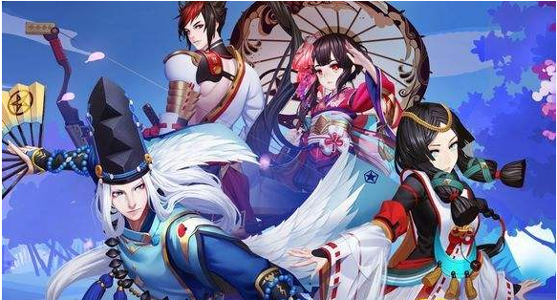


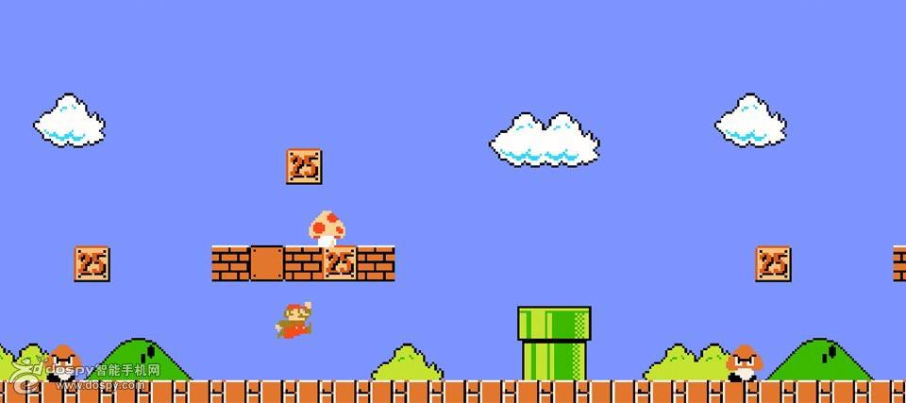
What can you think of when we talk about games?
×

Slide 2
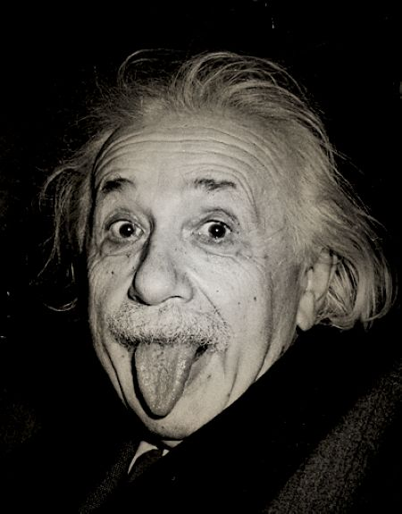
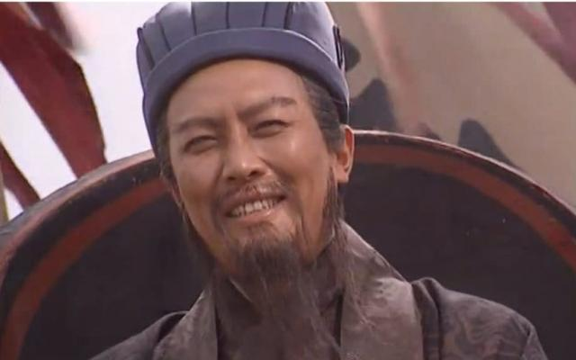
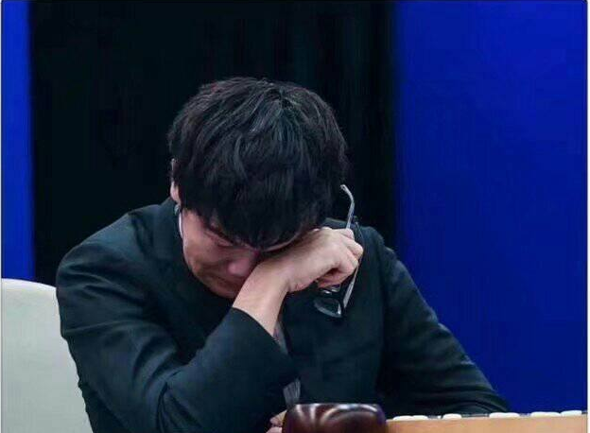

Slide 3
S！u！d！o！k！u！
数独

Slide 4
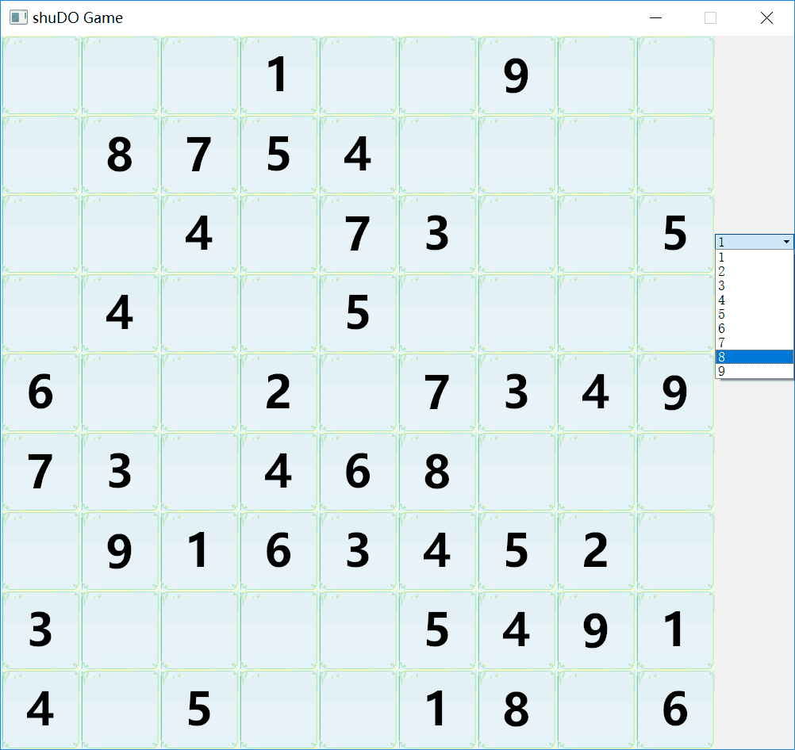
What is sudoku?

Slide 5
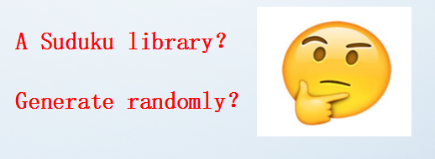
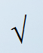
Overall Design
1.Menu、background music and window
2.Complete and right Sudoku tables
3.Cover numbers to make blanks
4.Change numbers into pictures
5.Mouse click、box and check

Slide 6
The main functions
How does it work when we play?

Slide 7
The highlights
Attractive
Menu,interface,background music,change numbers into pictures
Humanized
number box,mouse click,check and warning
Code
Generate complete table randomly
Use time function to achieve the real random

Slide 8
Harvest
1.Computational thinking way
2.Put theory into practice
3.Cooperation
4.Pain and happy

